Slide 1
39th International Conference on Software Engineering May 26, 2017 | Buenos Aires, Argentina Impact-Driven Process Model Repair (Journal-First ACM TOSEM Paper, DOI: 10.1145/2980764)
Artem Polyvyanyy ^{1,*}, Wil M. P. van der Aalst ^{2,1}, Arthur H. M. ter Hofstede ^{1,2}, and Moe T. Wynn ¹
¹ Queensland University of Technology, Brisbane, Australia
² Eindhoven University of Technology, Eindhoven, The Netherlands
* Presenting/corresponding author

Slide 2
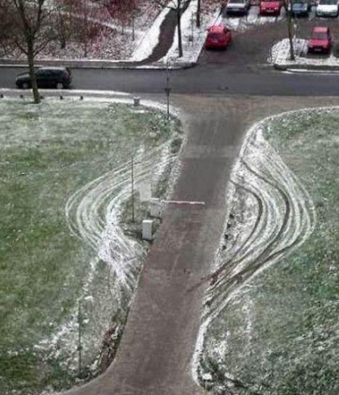
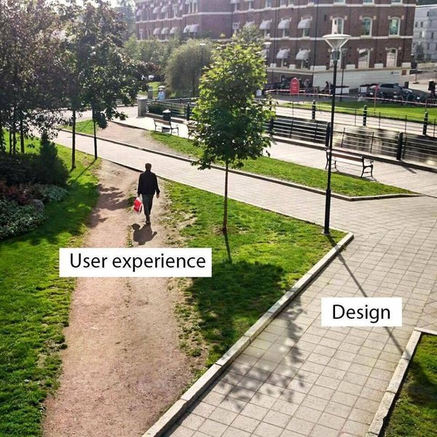
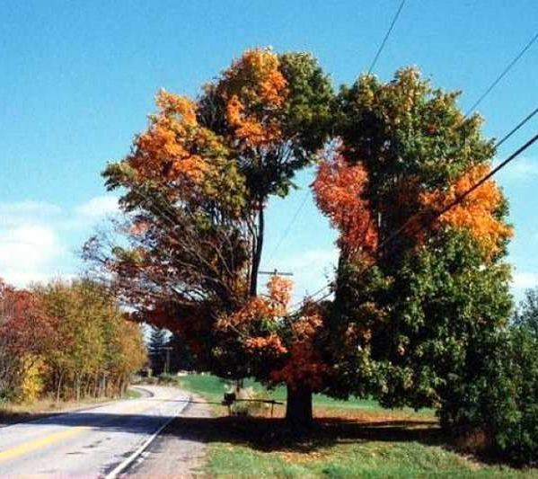
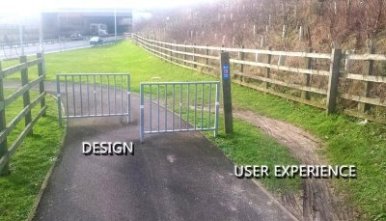
Deviances…

Slide 3
Conformance Checking
perfect alignments
real-world traces
a
b
c
a
d
e
γ₁ =
a
b
c
γ₂ =
a
d
e
t₁
t₂
t₃
t₁
t₄
t₅
designed traces
move on trace
synchronous move
move on model
a
b
x
e
≫
a
b
x
≫
e
a
≫
b
x
e
γ₃ =
a
b
≫
≫
c
γ₄ =
a
b
≫
c
≫
γ₅ =
a
d
≫
≫
e
t₁
t₂
t₃
t₁
t₂
t₃
t₁
t₄
t₅
0
0
1
1
2
4
0
0
1
2
1
4
0
3
1
1
0
5
+
+
+
+
=
+
+
+
+
=
+
+
+
+
=
cost(γ₃)=cost(γ₄)=4 and cost(γ₅)=5; γ₃ and γ₄ are optimal alignments!
Notes:
All synchronous moves have zero costs.
All non-synchronous moves not shown on this slide have the cost of one.

Slide 4
Process Model Repair
a
b
x
≫
e
a
≫
e
γ₄ =
a
b
≫
c
≫
γ₆ =
a
d
e
t₁
t₂
t₃
t₁
t₄
t₅
0
0
1
2
1
0
3
0
insert
skip
R=({x},{d})
Σ = 7
Note the problem with x!
a
b
x
≫
e
a
≫
b
x
e
a
≫
e
γ₇ =
b
x
c
γ₉ =
a
τ
γ₈ =
τ
a
≫
≫
≫
e
a
e
t₁
t₂
t₆
t₃
t₁
t₇
t₅
t₁
t₇
t₅
0
0
0
2
1
3
0
0
1
1
0
2
0
0
0
0
+
+
+
+
=
+
+
+
+
=
+
+
=
γ₈ and γ₉ are optimal alignments!
Σ = 2

Slide 5
Towards Optimal Repair
simulating repair via “free” moves
a
≫
b
x
e
a
≫
e
γ₁₀ =
γ₁₁
=
a
d
≫
≫
e
a
d
e
t₁
t₄
t₅
t₁
t₄
t₅
0
0
1
0
0
0
0
0
R=({x},{d})
Σ = 1
a
≫
b
x
e
a
≫
e
γ₁₂ =
τ
γ₈ =
τ
a
≫
x
e
a
e
t₁
t₇
t₆
t₅
t₁
t₇
t₅
0
0
1
0
0
1
0
0
0
=
0
+
+
+
+
=
+
+
γ₈ and γ₁₂ are optimal alignments! Note no problem with x!
Σ = 1

Slide 6
Optimal Repair (Theorem 5.3)
R=({x},{d})
There exist optimal alignments between the traces and the repaired model which:
Demonstrate that the traces fit the repaired model “at least as good” as they fit the original model;
“Fulfill” the repair recommendation, e.g., γ₈ and γ₁₂ contain no “bad” moves (x,≫) and (≫,d).
a
≫
b
x
e
a
≫
e
γ₁₂ =
τ
γ₈ =
τ
a
≫
x
e
a
e
t₁
t₇
t₆
t₅
t₁
t₇
t₅
0
0
1
0
0
1
0
0
0
=
0
+
+
+
+
=
+
+
γ₈ and γ₁₂ are optimal alignments! Note no problem with x!
Σ = 1
Notes:
The repaired model fits traces “at least as good” as the original model
The repaired model “fulfills” the repair recommendation; recommendation ({x},{d}) in the running example
There exist optimal alignments that do not contain “bad” moves; moves (x,≫) and (≫,d) in the running example

Slide 7
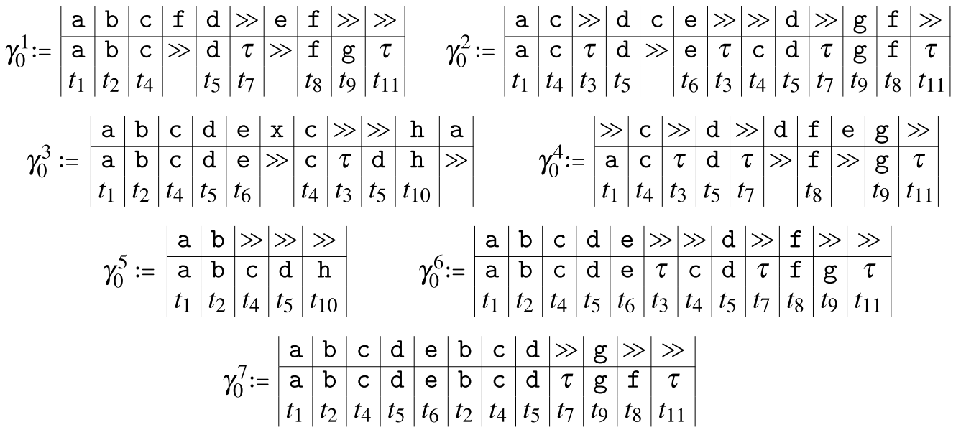
One More Example
10 x
9 x
9 x
7 x
6 x
2 x
All deviations cost one Peso!
2 x
Σ = 120

Slide 8
A Possible Repair
R = ({f,e,x},{c,f,g})
Σ = 47
insert
skip

Slide 9
Another Possible Repair
R = ({f,e},{g,d,e,c})
Σ = 33
insert
skip

Slide 10
Towards Optimal Repair Recommendation
R = ({f,x},{d,e,c,h})
insert
skip
Σ = 25
implemented heuristics
costs of repair recommendation
numbers of discovered recommendations
numbers of alignment computations
deviation costs

Slide 11
Conclusion and Future Work
In this work, we …
Defined, and proposed a solution to, the optimal process model repair problem
Defined, and proposed several (approximate) solutions to, the optimal repair recommendation problem
Developed a publicly available tool that implements all the invented techniques, https://svn.win.tue.nl/repos/prom/Packages/SelectivePRepair/Trunk/release/
Reported on lessons learned from experiments with real-world data, e.g., for small repairs proposed heuristics perform just as well as brute-force
Possible avenues for future work include:
Case studies to better understand requirements of process model repair
Aesthetic process model repair
Repair heuristics with guarantees
Repairs based on other conformance data structures
Repairs that go beyond trace fitness
Let’s work together:
Engage into research collaborations with us
Write your master and/or PhD thesis with us (scholarships available)

